Slide 1

Bài 15: Spring MVC
Giảng viên: Nguyễn Quang Huy
Email: HuyNQ12@topica.edu.vn
‹#›

Slide 2
FLOW?

Slide 3
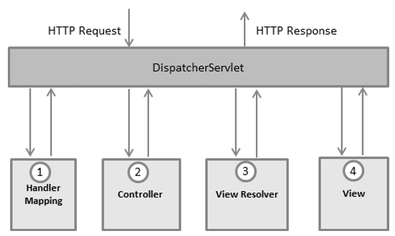
‹#›

Slide 4
@RestController vs @Controller?

Slide 5
@RequestParam, @PathParam, @ResquestBody

Slide 6
Thymeleaf

Slide 7
Security

Slide 8

‹#›

Slide 9
Task
Build an application use Spring Framework 5.x (Sring boot 2.x)
Business requirements:
Admin(must login): Can manage Word (id, key, mean, type) of Dictionary system
Add/Edit/Delete
List: pagging, filter by type, key
Import from file (files which provided before E-V, V-E)
User (doesn’t have to login): Can search any word, the system will detect the meaning (ex: to → English (đến), Vietnamese (to lớn), Suggested (tổ -> group, ...)
Technical requirement
Use Spring MVC + Thymeleaf + Bootstrap
‹#›

